Slide 1
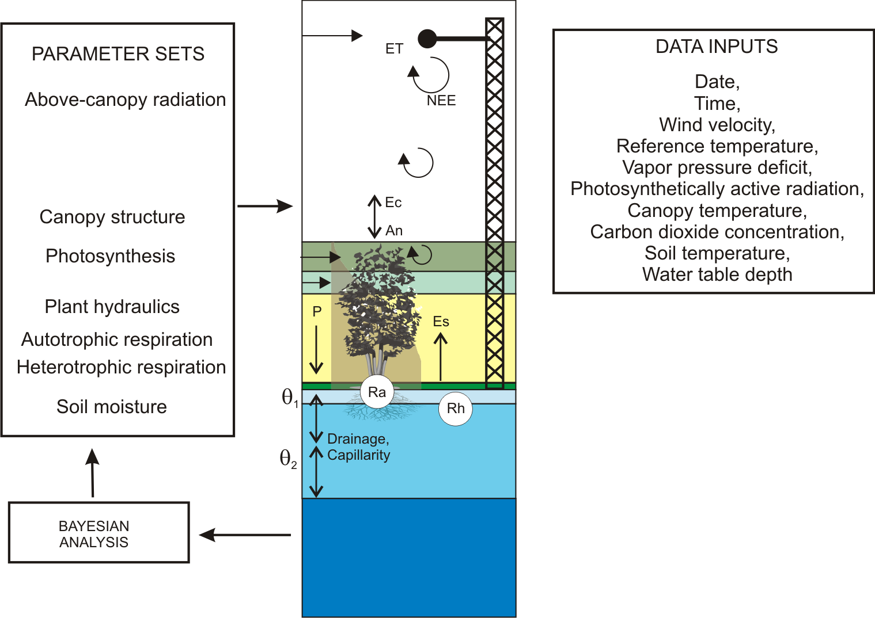
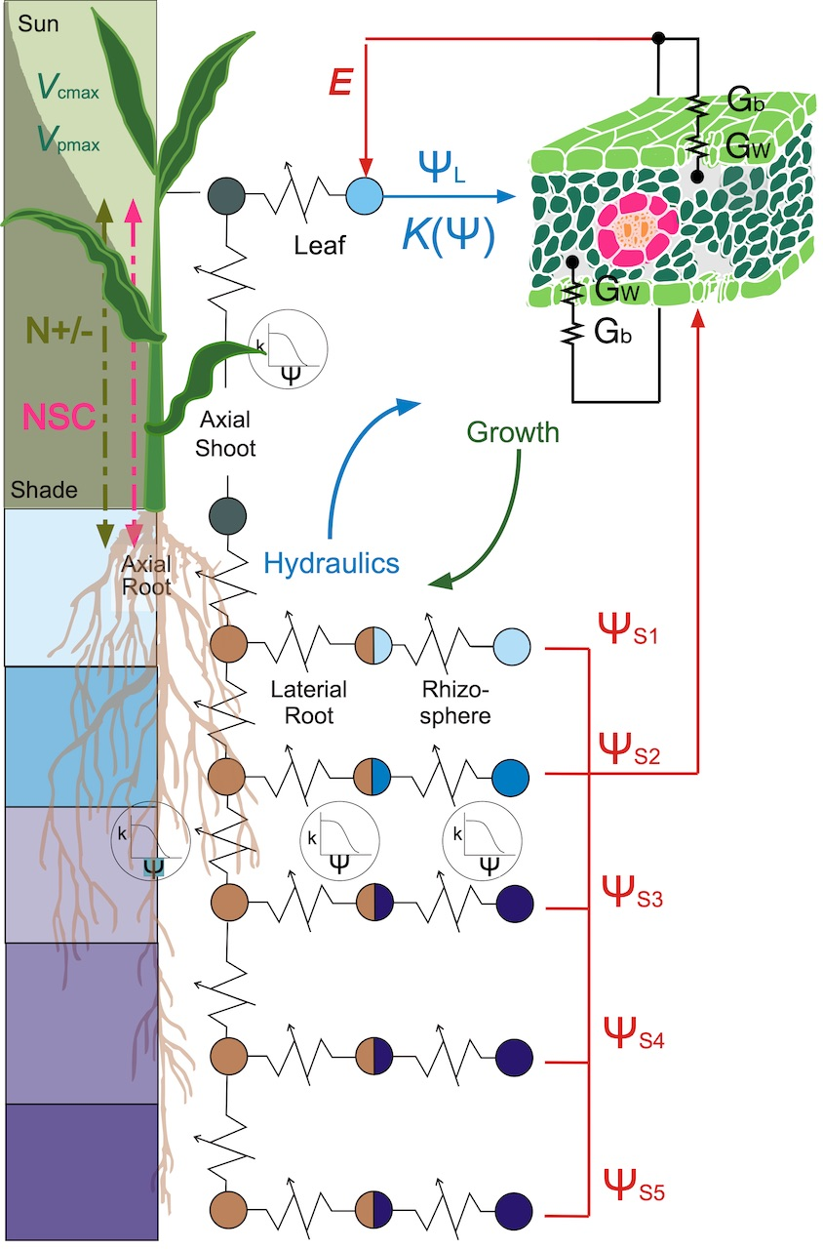
TREES Workshop:
Theory, Research Questions, and Hands-on Use
D. Scott Mackay, Mitchell Hitchcock and Diane R. Wang
University at Buffalo
Purdue University
Understand the major processes in TREES
Become comfortable with running TREES
Get data into TREES
Apply TREES to address research questions
Photo: Scott Mackay

Slide 2
Major Processes in TREES
1. Leaf/Canopy – energy relations
2. Leaf/Canopy boundary conductance
3. Photosynthesis (C3 and C4)
4. Vegetative growth
5. Soil-xylem hydraulics
6. Vadose zone soil physics
7. Nitrogen dynamics

Slide 3
1. Leaf/Canopy– energy relations
41.367 latitude
-105.238 longitude
Campbell & Norman 1998

Slide 4
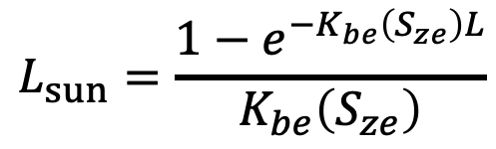
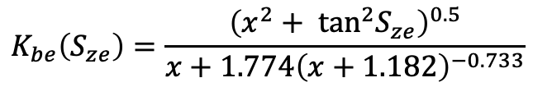
1. Leaf/Canopy– energy relations
$$K_{be}\left(S_{ze}\right)=\frac{{\left(x^{2}+ \tan^{2}S_{ze}\right)}^{0.5}}{x+1.774{\left(x+1.182\right)}^{−0.733}}$$
$$L_{sun}=\frac{1−e^{−K_{be}\left(S_{ze}\right)L}}{K_{be}\left(S_{ze}\right)}$$
1.0 l_angle, spherical, may sample
Campbell & Norman 1998

Slide 5
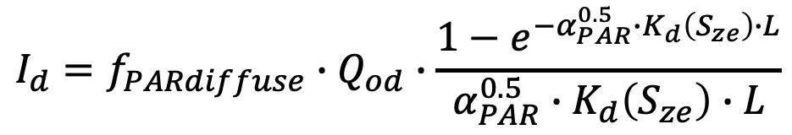
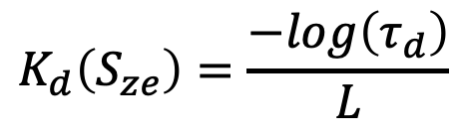
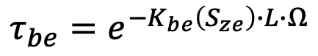
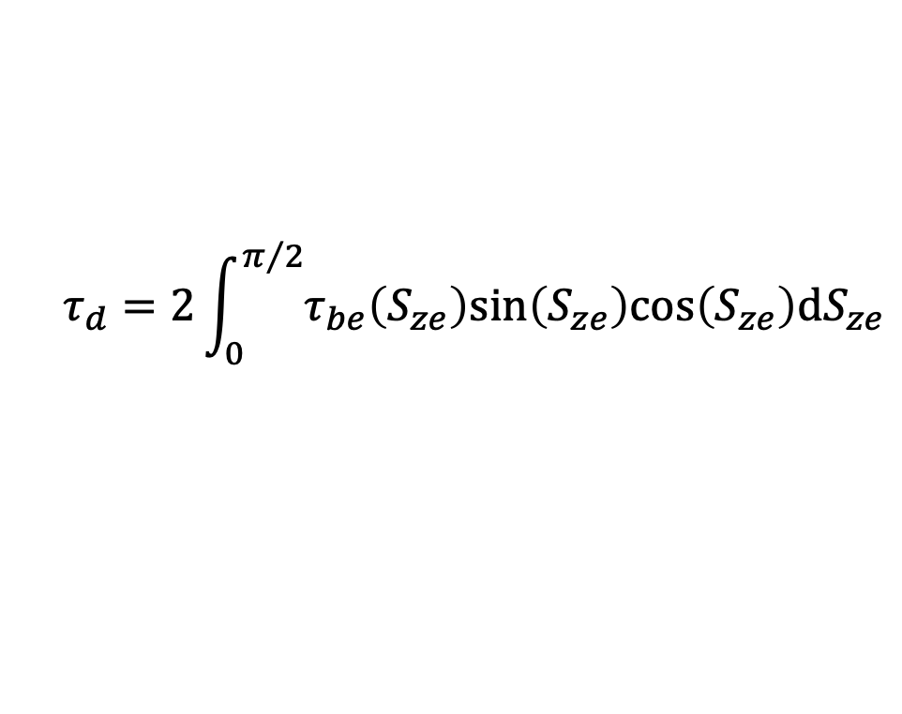
1. Leaf/Canopy– energy relations
$$K_{d}\left(S_{ze}\right)=\frac{−log\left(τ_{d}\right)}{L}$$
$$τ_{d}=2\int_{0}^{π/2}{τ_{be}\left(S_{ze}\right)sin\left(S_{ze}\right)cos\left(S_{ze}\right)dS_{ze}}$$
$$τ_{be}=e^{−K_{be}\left(S_{ze}\right)∙L∙Ω}$$
0.5 omega
$$I_{d}=f_{PARdiffuse}∙Q_{od}∙\frac{1−e^{−{α_{PAR}^{0.5}∙K}_{d}\left(S_{ze}\right)∙L}}{α_{PAR}^{0.5}∙K_{d}\left(S_{ze}\right)∙L}$$
0.8 alpha_PAR
0.5 fPAR_beam
0.5 fPAR_diff
Scattered light is also computed
Campbell & Norman 1998

Slide 6
2. Leaf/Canopy boundary conductance
0.3 canopy_height, m
0.5 d_factor, C&Nfig5.5
0.1 zm_factor, C&Nfig5.5
0.2 zh_factor, 7.19
X
0.45 z_ref, m

Slide 7
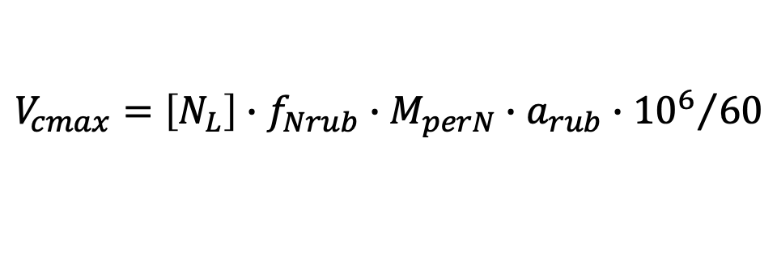
3. C3 Photosynthesis
= 0.5 V_{cmax}
$$V_{cmax}=\left[N_{L}\right]∙f_{Nrub}∙M_{perN}∙a_{rub}∙{{10}^{6}}/{60}$$
0.01 Rd_mult, Rd=Rd_mult*Vcmax
1.85 Jmax_mult, ratio of Jmax to Vcmax
0.80 thetaJ, curvature parameter
0.4 phiJ_sun, quantum yield, e-/photon
0.4 phiJ_shd, quantum yield, e-/photon
umol m⁻² s⁻¹ = kg Nleaf m⁻² x kg Nrub kg⁻¹ Nleaf x
kg Rub kg⁻¹ Nrub x umol kg⁻¹ Rub s⁻¹
f_{Nrub} = weight of Rubisco to its N content weight
= 7.16 kg Rub kg-1Nrub
3.6 act25, (umol/mgRubisco/min) Rubisco activity
0.001815 Nleaf
0.2 Nrubisco, proportion
These parameters give Vcmax = 155.9 umol m⁻² s⁻¹

Slide 8
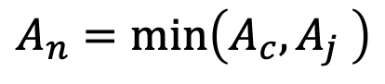
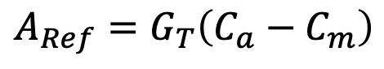
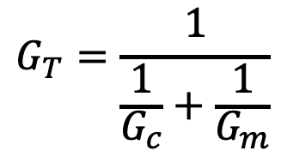
3. C4 Photosynthesis
$$A_{Ref}=G_{T}\left(C_{a}−C_{m}\right)$$
A_{ref} declines as C_{m} increases
A_{n} increases as C_{m} increases
Find where A_{n} = A_{ref}
$$G_{T}=\frac{1}{\frac{1}{G_{c}}+\frac{1}{G_{m}}}$$
$$A_{n}=min\left(A_{c}, A_{j} \right)$$
60.0 Vcmax25, maximum Rubisco activity at 25 C, umol m-2 s-1
100.0 Vpmax25, maximum PEP carbolylase activity at 25 C, umol m-2
400.0 Jmax25, maximum electron transport rate at 25 C, umol m-2 s-1
38.6 gammaStar25, compensation point at 25 C, umol
80.0 Kp25, Michaelis constant of PEP carboxylase for CO2 at 25 C, ubar
80.0 Vpr, PEP regeneration rate, umol m-2 s-1

Slide 9
4. Vegetative growth: Leaf (Brassica)
11.211 leafAreaMax // K
0.939134 initialLeafSize //A_pot_in
0.000495803 leafArea_Rate //r
11024.02 dur_LeafExpansion//d_exp
400.0 SLA_max //SLA_max
71.1034 SLA_min //SLA_min
60 leaf_insertAngle //
2.5 leaf_len_to_width //
0.90 proportion_CD //a
1970.534 phyllochron //phyllochron
13507.5 floweringTime //TTF
0.96 Tbase //Tb
4926.335 therm_plant
15.0 projectedArea_init
40.0 pot_size //max projected area, cm2
0.43 root_to_shoot
1.59 leaf_to_stem
Wang et al., 2019, Journal of Experimental Botany

Slide 10
4. Vegetative growth: Roots
#_of_shoot_modules 1
leaf_area_fraction 1
length_lateral 0.48
length_axial 0.2
#_of_root_modules 4
leaf_area_fraction 0.2
length_lateral 1.0
length_axial 0.008
leaf_area_fraction 0.2
length_lateral 1.0
length_axial 0.016
leaf_area_fraction 0.3
length_lateral 1.0
length_axial 0.024
leaf_area_fraction 0.3
length_lateral 1.0
length_axial 0.048
Axial length = 0.096 m
Lateral length = 0.096 x 1.0 = 0.096 m
Mackay et al., 2020, New Phytologist

Slide 11
4. Vegetative growth: Roots
79200.0 Cbelowground, kg ha-1
0.00024 Croot_frac, dim
1454.0 SRL1, m gC-1 at root diameter of 250 um
0.000125 minRootDiam, m diameter of thickest root
0.004 maxRootDiam, m diameter of thickest root
1.0 minRootLifespan, years,
Mackay et al., 2020, New Phytologist

Slide 12
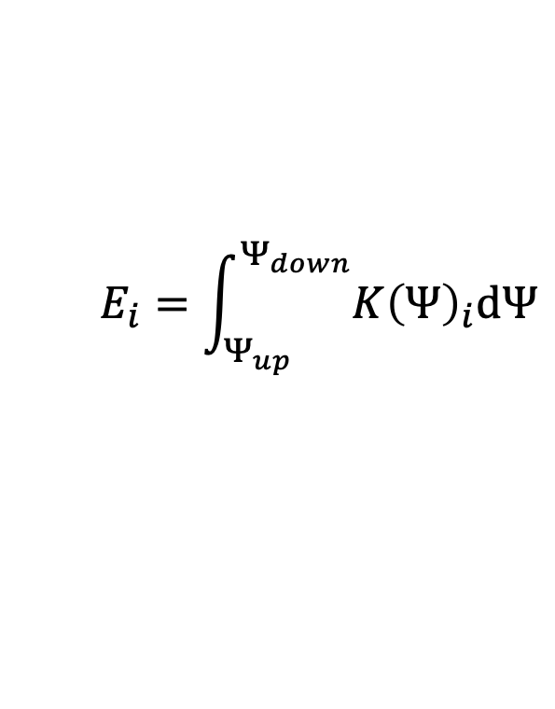
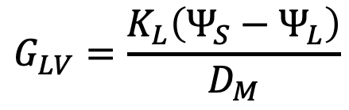
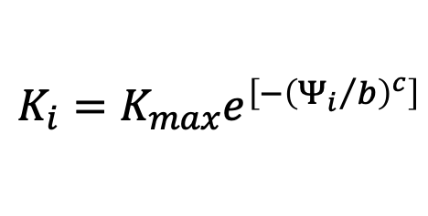
5. Soil-Xylem hydraulics
0.15 Gsref
0.54 m (proportion of Gsref)
$$G_{LV}=\frac{K_{L}\left(Ψ_{S}−Ψ_{L}\right)}{D_{M}}$$
$$E_{i}=\int_{Ψ_{up}}^{Ψ_{down}}{{K\left(Ψ\right)}_{i}dΨ}$$
-0.3 pd_at_sat_kl
-0.5 midday_at_sat_kl
2.5 e_at_saturated_kl
1.57 ax_Shoot-b_value_(weibull)
2.38 ax_Shoot-c_value_(weibull)
1.57 lat_Shoot-b_value_(weibull)
2.38 lat_Shoot-c_value_(weibull)
1.57 ax_Root-b_value_(weibull)
2.38 ax_Root-c_value_(weibull)
1.57 lat_Root-b_value_(weibull)
2.38 lat_Root-c_value_(weibull)
$$K_{i}=K_{max}e^{\left[−{\left({Ψ_{i}}/b\right)}^{c}\right]}$$

Slide 13
6. Soil Physics
0.4 porosity
0.3 silt_fraction
0.3 clay_fraction
Drainage:
Explicit Richards Equation
Film flow (macropores)
0.085 GMP_(mm)_geometric_mean_particle_diameter
18.0 GSD_geometric_standard_deviation_of_particle_size

Slide 14
7. Nitrogen dynamics

Slide 15
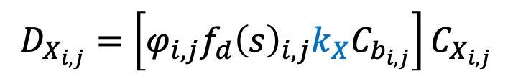
7. Nitrogen dynamics
(Litter)
0.0085 kd, d-1
0.6 kn, m3 d-1 gC-1
0.4 kea, m3 d-1 gC-1
0.6 kes, m3 d-1 gC-1
0.000065 kl, m3 d-1 gC-1
0.0000025 kh, m3 d-1 gC-1
(Humus)
(Amino acid)
$$D_{X_{i,j}}=\left[φ_{i,j}f_{d}{\left(s\right)}_{i,j}k_{X}C_{b_{i,j}}\right]C_{X_{i,j}}$$
(Glucose)

